Slide 1

DSBA: Getting started with Python
ERASMUS Q-INTELLIGENCE

Slide 2


Introductie
Sinds September 2024: Full-Stack Developer @ Erasmus Q-Intelligence Betrokken bij verschillende projecten:
Equal Pay Dashboards
Voorraad voorspellingen (FCast)
CrossOver+ - Nier transplantatieprogramma
2022 - 2024: Jr. Developer @ Eformity. App voor het automatisch genereren van templates voor bedrijven
2019 – 2024: MSc Software Engineer, Fontys Eindhoven
Onderzoek naar het automatisch detecteren van stress via wearables en de benodigde software-infrastructuur daaromheen.
Sebas Bakker
Programmeer ervaring in: C#, Java, JavaScript, PhP en Python

Slide 3
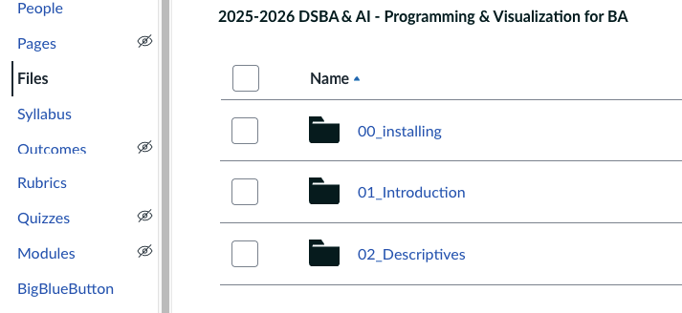
Course progression
Canvas: Programming and Visualization for BA
Midterm assesment
Final assesment

Slide 4
AGENDA
Today
Introduction
Getting started with Python and Notebooks
Packages
Data imports
Data transformeren
Data exploreren

Slide 5
Python resources
Interactive online learning platform DataCamp:
http://www.DataCamp.com
Basic and advanced interactive Python tutorials LearnPython:
https://www.learnpython.org/
W3Schools:
https://www.w3schools.com/python/
Boek:
https://jakevdp.github.io/PythonDataScienceHandbook/

Slide 6
What is Python used for?
Web development
Back-end frameworks like Django and Flask
Software development
Cross-platform GUIs with Tkinter
Scripting
File conversion, data transformations, calculations, etc.
Data Science
Data collection with Scrapy and BeautifulSoup
Data analysis with NumPy, Pandas, SciPy
Visualisation with Matplotlib
Machine Learning with scikit-learn
Deep Learning with TensorFlow, Keras, PyTorch

Slide 7
Who Uses Python?
Dropbox
Quora
SalesForce
NASA
Reddit
Instagram
Facebook
Google
Amazon
Spotify
Netflix
Uber

Slide 8
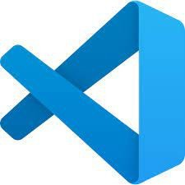
VISUAL STUDIO CODE
Visual Studio Code is an Integrated Development Environment (IDE) by Microsoft
Easy to use
Supports more than 50 programming languages, including Python
Lots of extensions and plugins to customise it to your own preferences

Slide 9
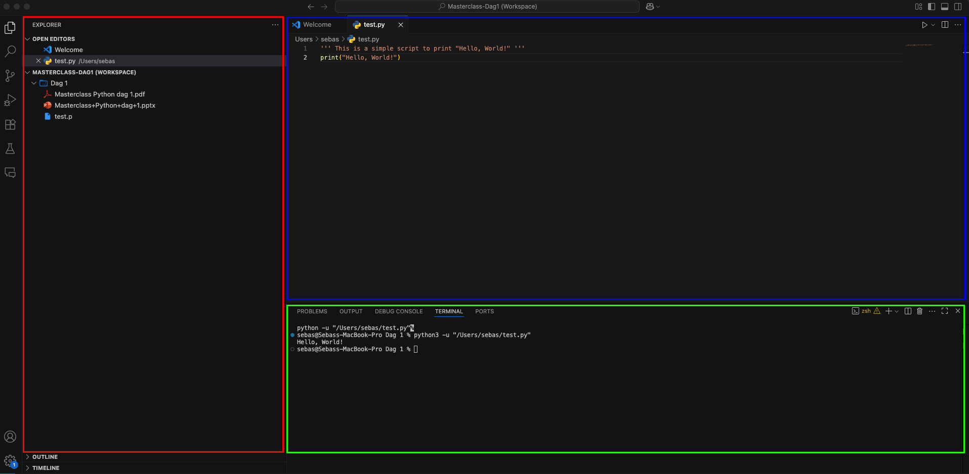
USING VS CODE
EDITOR
TERMINAL
EXPLORER

Slide 10
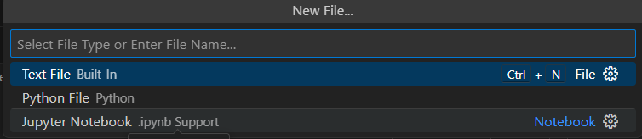
JUPYTER NOTEBOOKS
Fast prototyping by adding and executing small blocks of code
Reproducibility
Visualisation with markdown text to give clear info on your data
Easy to use same analysis on different dataset (e.g. periodic reports)
Jupyter Notebooks: .ipynb files to run interactive Python-code

Slide 11
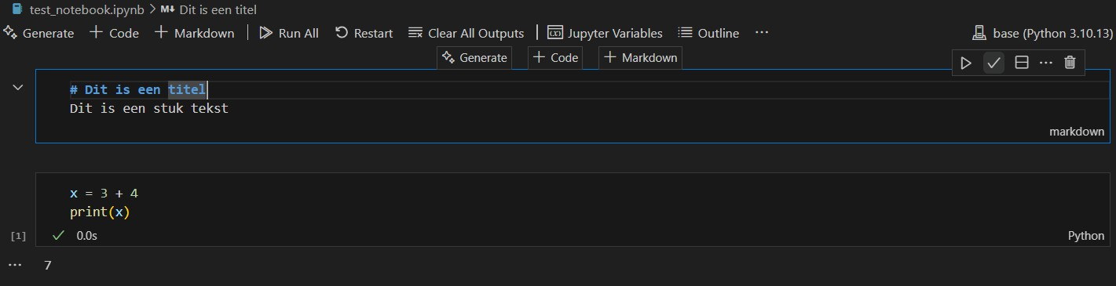
JUPYTER NOTEBOOKS
Notebooks contains cells:
Markdown-cell (text)
Python-cell
Format de Markdown-code
MARKDOWN
PYTHON
You may have to install the ipykernel package through: pip install ipykernel

Slide 12
Exercise 1
Download my_first_notebook.ipynb from canvas and open it in Visual Studio Code.
Run each cell by clicking the Run button in the toolbar, or by pressing the run all button

Slide 13
Using Python
To use Python (eﬃciently) you need to understand:
1 Diﬀerent types of objects and how they behave
2 Various functions and what they do
This takes time, but it is worth it!

Slide 14
DATA TYPES
Every Python-object has a type
Basic types:
Numeric
int: integer, whole number
float: decimal or fraction (costs more memory)
Boolean: objects with value True or False
String: object containing text, indicated using single or double quotes on both sides (‘ ‘ / “ ”)
The value None can be used in every type, but it is used to indicate a missing value.
Notes:
Floats zijn kommagetallen maar worden geschreven met een . als in 3.5

Slide 15
PYTHON OBJECTS
Every bit of data in Python (a number, text, list) is an object
An object has a value, a type and a spot in the memory
A variable is a name that references an object
A variable can be named whatever you want, but must no contain any special characters. (Except _)
Variable object object
klantID_a = 10001 klantID_b = klantID_a klantID_b = klantID_b + 1
print("Klant ID A:", klantID_a)
print("Klant ID B:", klantID_b)

Slide 16
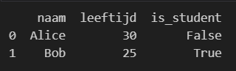
DATA STRUCTURES: DATA FRAMES
A commonly used datastructure for tabels is a pandas.DataFrame
2-dimensional (rows and columns)
Each columns can have a different datatype
Great for loading and manipulating CSV/Excel data
Select a column with: <dataframe>["<key>"]
import pandas as pd
data = {
"naam": ["Alice", "Bob"], "leeftijd": [30, 25], "is_student": [False, True]
}
df = pd.DataFrame(data) print(df)
Notes:
ILOC is beter voor indexen, omdat loc’s standaard waarde key pakt
Verschil: df2 = pd.DataFrame(data, index=[1, 2])
print(df2.loc[1]) # Tweede rij van df2
Een rij selecteer je met <naam>.loc[<index>]
Een cel selecteer je met <naam>.loc[<index>,<key>]

Slide 17
Functions & objects
All actions are performed by functions:
We used print(x), len(x) and sum(x)
Takes an object (or objects), and returns a transformed result
Functions are pieces of code that perform specific actions
For example, sum() calculates the sum of array elements
Use the help() function to get documentation on a function e.g. help(print)
Functions accept objects as arguments
Data to compute on and other options that control output
For example, age is an array object containing ages

Slide 18
Packages

Slide 19
Virtual Environments
Isolates installed packages in its own environment
Makes sure everyone is using the same packages
Needs to be created per project
After creating a virtual environment you have to activate it and set it as your interpreter in VSCode
Notes:
the -m flag means "run a library module as a script".
https://www.w3schools.com/python/python_virtualenv.asp

Slide 20
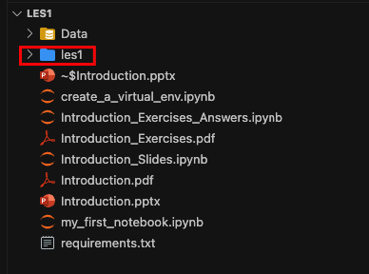
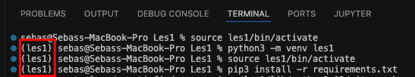
Virtual Environments – Setup
For Windows use:
les1\scripts\activate
Instead of:
source les1/bin/activate
Use the following commands in your terminal (mac/Linux):
python3 -m venv les1
source les1/bin/activate
pip3 install –r requirements.txt
When a venv is activated it should show in your terminal as (les1)
Result: a new folder called “les1”, where all your packages are stored

Slide 21
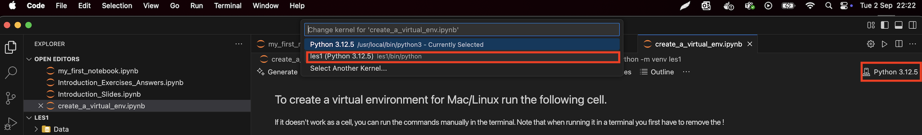
Virtual Environment - Interpreter
Visual Studio Code needs to know which Python version to use.
We need to set it to the Virtual Environment or it will take a global version instead

Slide 22
PYTHON PACKAGES
Functions generally come from packages
Frequently used packages are for example:
numpy
pandas
matplotlib en plotly
scikit-learn
alias
import numpy as np
x = np.array([1, 2, 3]) print(np.mean(x))
Some packages come pre-installed with Python, i.e. math, datetime, random
Most other packages must be installed manually first through pip install <package>
After they are installed, they have to be imported in your Notebook using import <package>
Notes:
Pip install / pip3 install numpy
https://www.w3schools.com/python/python_virtualenv.asp
Venv nodig: https://peps.python.org/pep-0668/

Slide 23
Exercise 2
Download and open the Introduction_Exercises.pdf file from Canvas, and do Exercises 1.1 and 1.2

